Slide 1
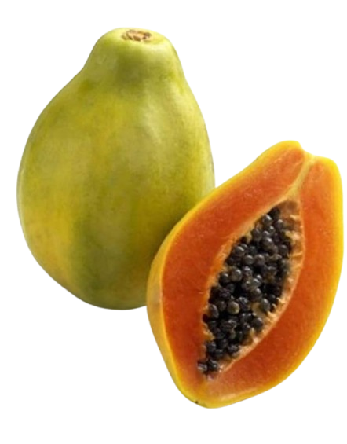
Commercial Fruit Crop Production and Post-Harvest Technology
Class 11 (Technical)
Unit – 3
Cultivation of Fruit Crops
PAPAYA
Prepared By:
Harichandra Singh (Harish)
B.Sc.(Hons.) Agriculture
Instructor at SVBHSS
+977 9840213344

Slide 2
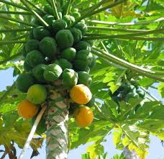
Content:
Introduction
Area, Production & Productivity
Soil & Climate
Propagation
Cultivars
Nutrition
Training & Pruning
Cultural Operation
Pest Management
Fruiting
Harvesting
Post Harvest Handling
Marketing

Slide 3
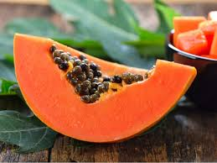
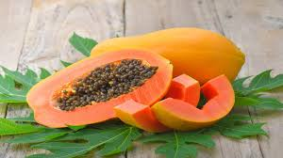
Introduction
Botanical Name: Carica papaya
Family: Caricaceae
Origin: Lowlands of central America & southern Mexico
It is a single, hollow-stemmed herbaceous dicot plant.
Importance:
It is rich source of vitamin A (Beta carotene) & Minerals.
Ripen fruits can be eaten fresh as breakfast & dessert fruit.
It can be processed as jelly, marmalade, candies, crystallized fruits etc.
It also considered good for Jaundice patients.
Used for papain extraction etc.

Slide 4
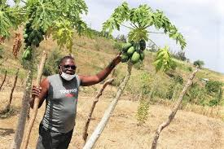
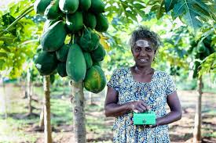
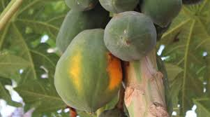
Area, Production & Productivity
Major papaya producing countries are Sri Lanka, South Africa, Australia, India, Nepal etc.
In Nepal Udayapur, Jhapa, Dhanusha, Mahottari, Kavre, Dang, Kailali, Kanchanpur are the major papaya producing districts.
Kavre has the maximum acreage.

Slide 5
Soil & Climate
It can be cultivated in wide range of soil but loam and sandy loam is ideal for commercial cultivation.
The soil should have high OM
Good drainage facility
pH should be 6 - 7.5
Water logging exist over 48 hrs. cause collar rot.
It can be cultivated in tropical and subtropical region up to an altitude of 1000 MASL.
Ideal temperature is 22-26°C
It require a plenty of water, 150-200 cm annual rainfall.
Drought condition cause flower sterility and induce maleness.
Frost is harmful thus, <10°C temperature is not suitable.

Slide 6
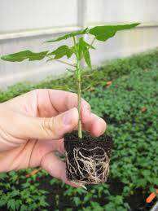
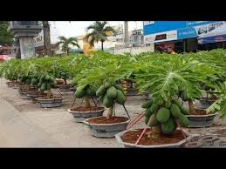
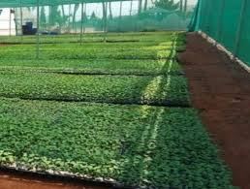
Propagation
It is propagated by seed.
Cutting & Tissue culture is also followed.
Seed are sown in polybag or directly sown in a well prepared nursery bed at 15cm*20cm spacing.
Seedling become ready for transplanting when plant attain height of 15-20cm and have 4-5 leaves.

Slide 7
Cultivars
Pusa Delicious:- Yield & Quality of this variety is good. Excellent fruit taste. It is a gynodioceous (Hermaphrodite in one plant & female on another plant) variety with 100% productive.
Pusa Majesty:- It is High productivity & better keeping quality of ripe fruit. Also Gynodioceous vaiety with rich source of papain. Resistant to papaya nematode.
Pusa Giant:- It is a vigorous dioecious variety with good size of fruits. Tolerant to strong winds & storms.
Pusa Dwarf:- Medium sized fruit with oval shape which is preferred by consumers.
Pusa nanha (mutant dwarf):- Extremely dioecious suitable for kitchen gardening, pot & roof cultivation. Ideal for high density orcharding.
Washington:- Plants are vigorous, stem & leaf stalks are with purple tinge, fruit are medium to large, round to ovate with good flavour.

Slide 8
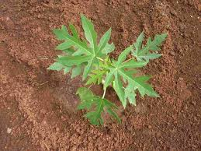
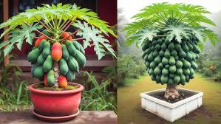
Planting
Planting of papaya is done during monsoon season (Asar - Saun) / (June- July)
The pit size of 1-1.5 cubic feet should be dug at 1.8*1.8m or 2.4*2.4m apart & filled with top soil mixed with 5kg of FYM, 100gm of neem cake & 40gm of SSP.

Slide 9
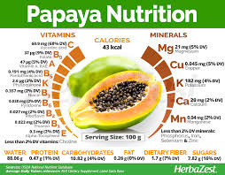
Nutrition

Slide 10
Training & Pruning
Papaya plants do not require special training & pruning, however, during heavy fruiting, some supports can be provided to avoid breakage & lodging of plant.

Slide 11
Cultural Operation
A. Manure & Fertilizer Application
The recommended dose of compost, nitrogen, phosphorus and potassium should be:
Compost: 25kg per plant per year
Nitrogen: Phosphorus: Potassium: 400:250:400 g/plant/year.
The fertilizer application is done in 2 splits; one in Shrawan/Bhadra and other split in Falgun.
B. Intercropping
No intercrop should be taken when flowering and fruiting starts.
Intercropping of leguminous crop after non leguminous one, shallow-rooted crops after non-leguminous one and shallow-rooted crops after deep rooted ones are gainful.

Slide 12
Cultural Operation
C. Irrigation
Irrigation depend upon soil type and availability of water.
Irrigation is necessary during flowering stage.
Irrigation is required at 5-6 days interval in summer and 10-15 days interval in winter by adopting ring method.
Water logging condition is avoided from the base of the plant. (Rotting of rhizomes)
D. Weeding
Deep hoeing is recommended during the first year to check weed growth. Weeding should be done on regular basis especially around the plants.
Earthing up is done before or after the onset of monsoon to avoid water-logging and also help the plants to stand erect.

Slide 13
Disease Management
Collar rot ( stem rot):- Causal organism: Fungus
S.n.: Pythium aphanidermatum
Symptoms:
Water soaked patches appear on the colar region of the plant.
Later on the patches appear in large size and cause rotting of tissue. The pant fall and die in severe condition.
Control:
Avoid water logging condition in field
Uproot and destroy the affected plant
Application of Trichoderma viridae (15 g/plant) mixed in well decomposed FYM should be applied around the root zone of the plants at the time of planting.
At the initial stage, scrap the infected part and apply Bordeaux paste.

Slide 14
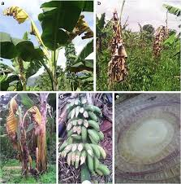

Slide 15
Disease Management
2. Anthracnose:- Causal organism: Fungus
S.n : Colletotrichum gloeosporioides
Symptoms:
Small black spots appear on the leaves and fruits.
The spots increase in size, penetrating and rotting the internal flesh.
The affected leaves fall pre-maturely.
Control:
Collect and destroy infected leaves and fruits.
The fruits should be harvested as soon as they mature.
Spaying with Copper Oxychloride (3 g/litre of water) or Carbendazim (1 g/litre of water) at 15 days interval effectively controls the disease.

Slide 16
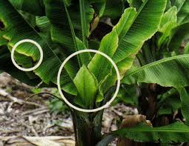
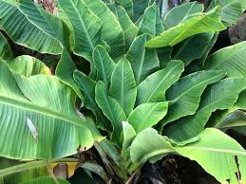

Slide 17
Disease Management
3. Leaf curl Causal organism: Leaf Curl Virus
Vector: White fly (Bemisia tabaci)
Symptoms:
Curling and bending of leaves takes place which cause reduction in the leaves size.
The leaf margin rolled downward and the affected leaves become zigzag.
Later on defoliation takes place.
Control:
Collect and destroy the infected part of the plant.
Removal and destruction of the affected plants is the only control measure to reduce the spread of the disease.
Checking the population of white flies also can reduce the infection severity.

Slide 18
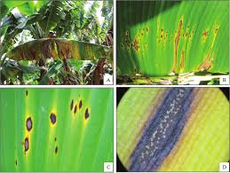

Slide 19
Pest Management
Rhizome Weevil:
The larva feed on and make tunnel in the rhizome. Tunnel may go one meter up into the stem.
Symptoms:
Leaves turn yellow, wither and die prematurely.
Other pathogens attack the weakened plant, which eventually dies.
Management:
Dip plant material in Monocrotophos (0.1%) before planting.
Dust Chloropyriphos 100g/pit at the time of planting
Maintain good sanitation by trapping, dipping and field treatment.

Slide 20
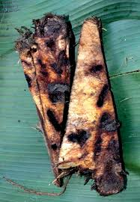

Slide 21
Pest Management
2. Pseudo-stem Weevil:
Symptoms:
The grub feed on the leaf sheath initially, then bore into the pseudo-stem which becomes weak and rots, causing plants to die.
Management:
Dip plant material in Monocrotophos (0.1%) before planting.
Dust Chloropyriphos 100g/pit at the time of planting
Maintain good sanitation by trapping, dipping and field treatment.

Slide 22
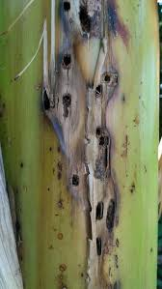
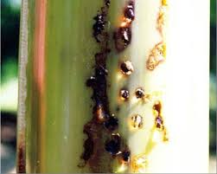

Slide 23
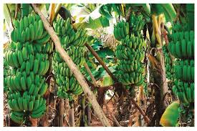
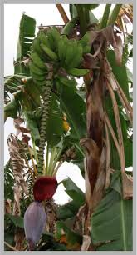
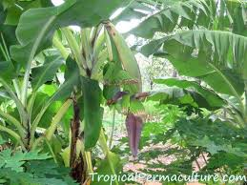
Fruiting
Normally, banana plant flower in 8-12 MAP & require 3-4 Month for maturity.
Banana flowers in clusters, each may have 12-20 flowers.
Basal nodes have female flowers, upper ones mostly male flowers.
Fruit is berry type and usually seedless (Parthenocarpic)

Slide 24
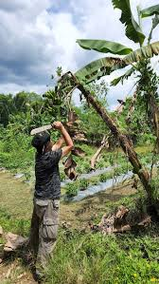
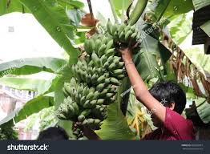
Harvesting & Yield
Dwarf varieties are harvested after 12-15 months while tall ones are after 15-18 month of planting.
The whole bunch is harvested when fingers are plump and light green and corners are rounded rather than angular.
For export or distant market it should be harvest at green stage when fingers are well developed but still angular.
Banana produces 10-25 MT of fruits/ha/crop.
Yield may go up to 20-55 MT/ha.

Slide 25
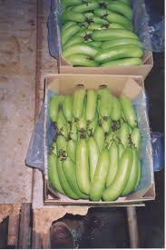
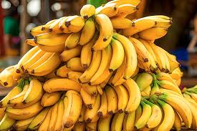
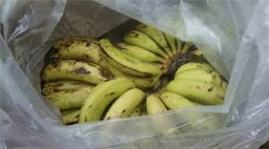
Post Harvest Handling
After harvesting of banana, we must store them at suitable location depend upon purpose of storage.
Banana can be stored for 3 weeks at 13-15°C at 85-95% RH.
Storage can be prolonged when treated with wax emulsion.
Simple polythene bagging with 0.2% holes extends storage life by one week at room temperature.
Banana fruit may be induced to quick ripening by providing smoke in storage room.
Dumping of banana bunches in closed rooms for a few days allows natural ripening with good color.
Smoking from burning straw, dried leaves etc. in a room or in pits will ripen banana within 3-5 days.

Slide 26

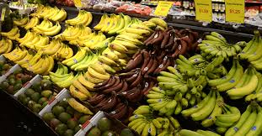
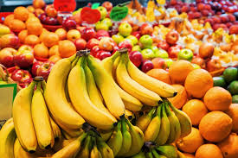
Marketing
Banana has National & International demands, so that we can supply those market.
To get higher price bunches must be graded properly based on fingers per hand or bunch, finger size and shape, varietal trueness etc.

Slide 27
Thank You For Your Attention……
Any Question ???
See You In Next Class !!

